Slide 1
Online Nurse Appointment System
Mayank Kumar Singh (200667)
Amit Kumar Maddeshiya (200746)
Nitansshu Jain (200735)
Neetu Pandit (200747)
Piyush Devda (200664)

Slide 2
Requirements
Java [JDK 8+]
Eclipse
MySQL
MySQL Workbench
Jdbc Driver
MySql Connector

Slide 3
Introduction
Menu Driven program for online nurse appointment through command line.
Perform CRUD operations w.r.t Customer, Nurse and Services.
Book an appointment with all relevant details.

Slide 4
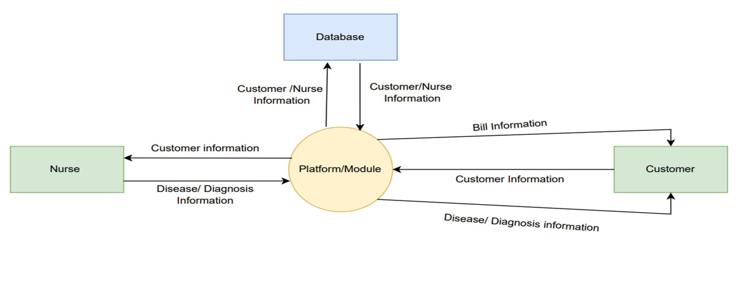
Architecture

Slide 5
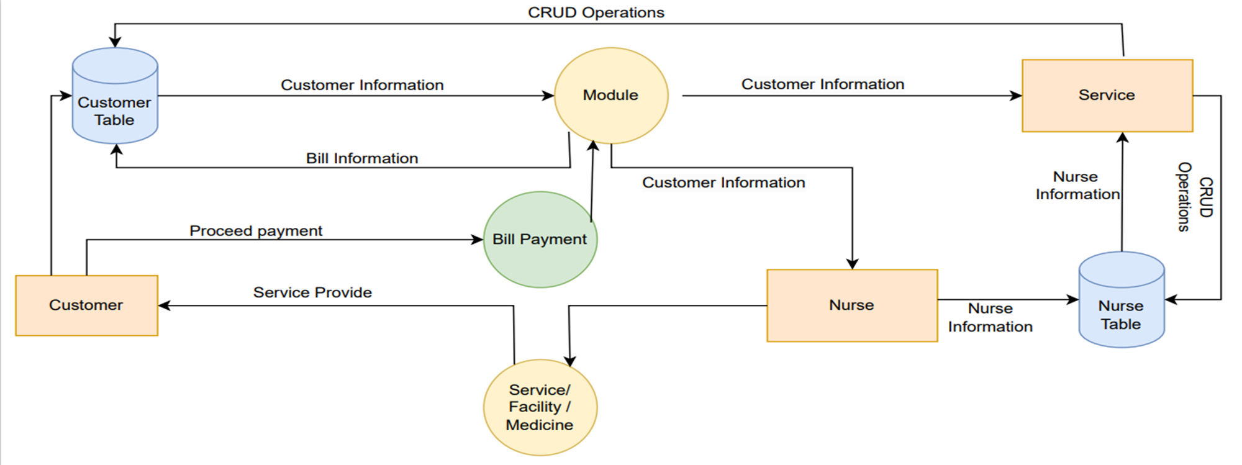
Architecture

Slide 6
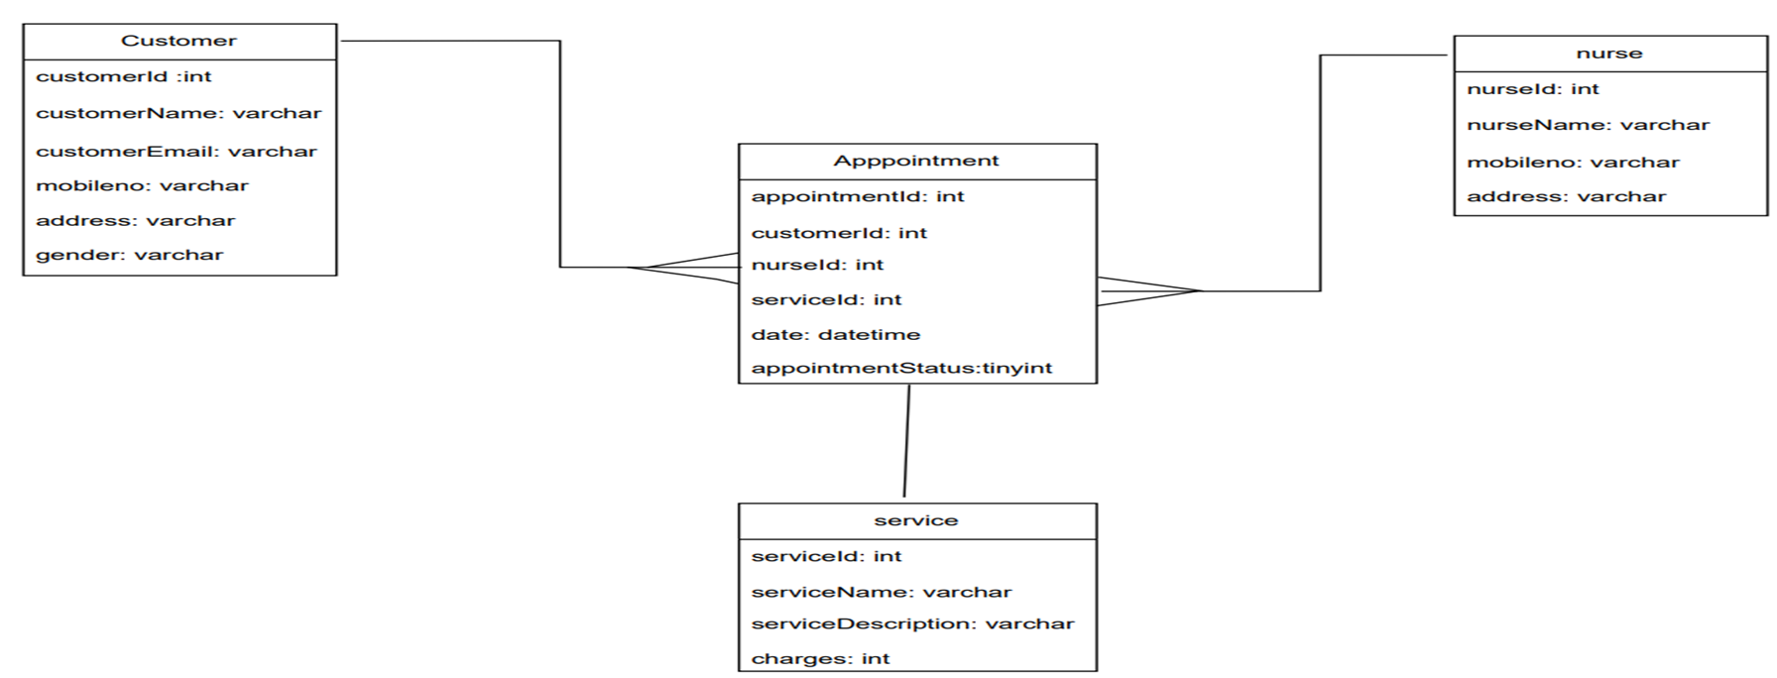
Class Diagram

Slide 7
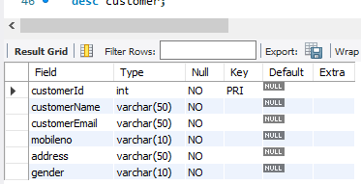
Features (Customer)
Register a customer
Modify details of customer
Delete details of customer
View single customer
View all customers

Slide 8
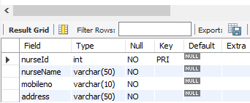
Features (Nurse)
Register a nurse
Modify details of nurse
Delete details of nurse
View single nurse
View all nurses

Slide 9
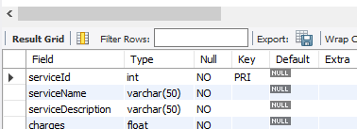
Features (Service)
Insert service details like name, description, etc
Modify details of service
Delete details of service
View single service
View all services

Slide 10
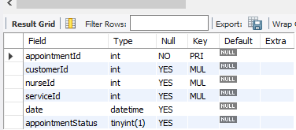
Features (Appointment)
Book an appointment
Modify an appointment
Delete an appointment
View single appointment
View all appointments

Slide 11
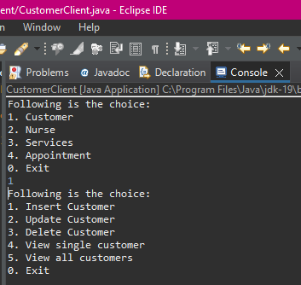
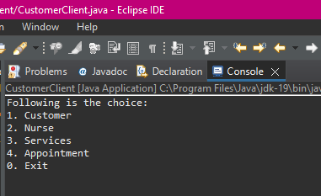
Screenshots

Slide 12
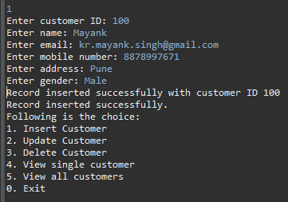
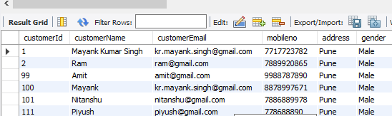
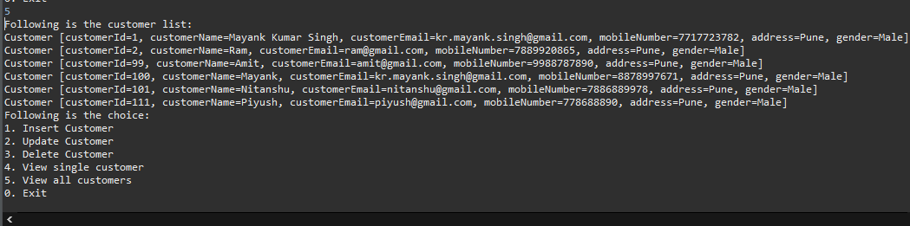

Slide 13
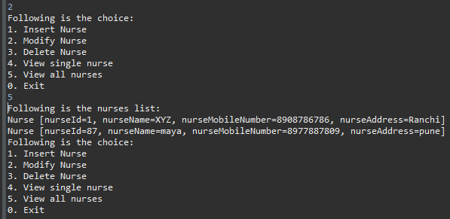
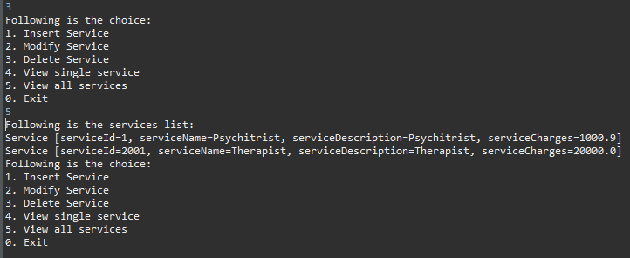

Slide 14
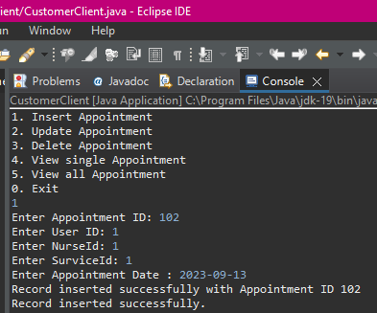
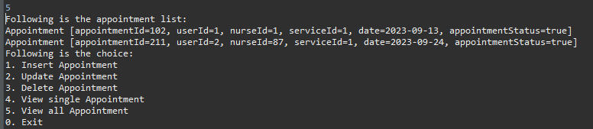

Slide 15
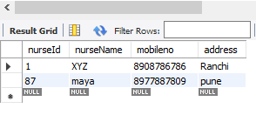

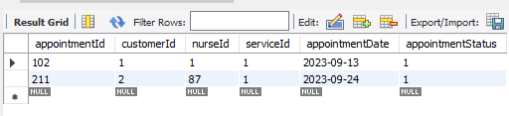
Customer Table
Nurse Table
Service Table
Appointment Table

Slide 16
Thank You!!

